Slide 1

Capstone Project
Group Members
Joshua Kanda
Shunmon Peter Bala
Team Leader
Olasehinde Ezekiel
Supervisor
Bui Dinh Chien

Slide 2
Introduction
Project Management
Software Requirement
Software Design
Testing
Demo

Slide 3
Introduction
Overview
Bookstore Management System has been one of the trending type of web based applications this days. This is a complete customize version of the solution that have been use by many bookstore up till date

Slide 4
Introduction
Overview
dissecting our application you will notice that Staff users can Add book, Update Book Information, as well as Delete, same functionality is allow of the staff for Author, Category and Many more, whereas the Admin of the system oversees the overall system and customer is allow to keep track of their favorite books.

Slide 5
Introduction
BSMS is designed to manage information and keep records
Designed in such a way that customers will be able to keep track of books information

Slide 6
Introduction
Modules
System Search
Staff Management
Profile Management
Authentication Management
Book Management
Wish list Management
Profile Management
Author Management
Producer Management

Slide 7
Project Management
1
Software Process Model
2
Roles & Responsibilities
3
Project management plan
4
Risk management
5
Tools and Techniques

Slide 8

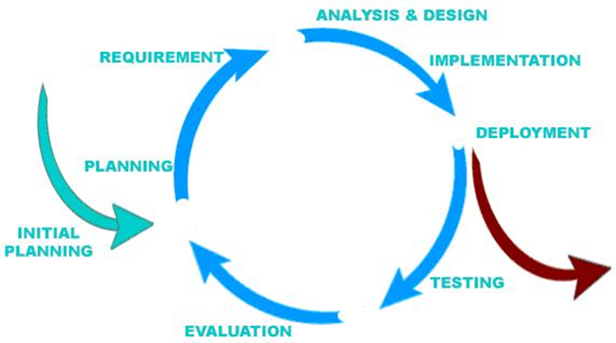

Software Process Model
Develop iteratively
Manage requirements
Use components
Model visually
Ensure quality

Slide 9
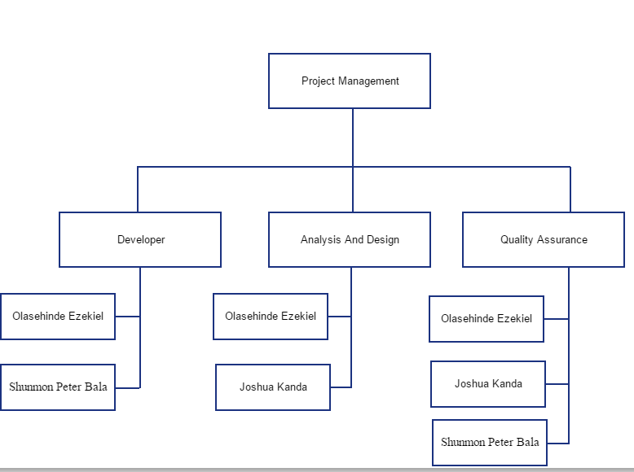
Roles And Responsibility

Slide 10
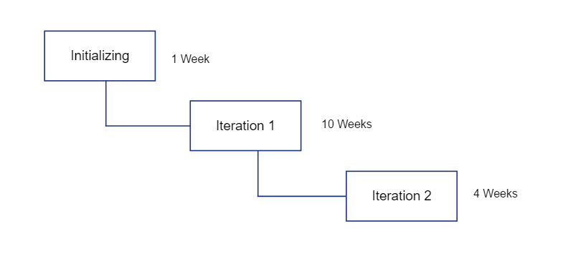
Project Management Plan

Slide 11
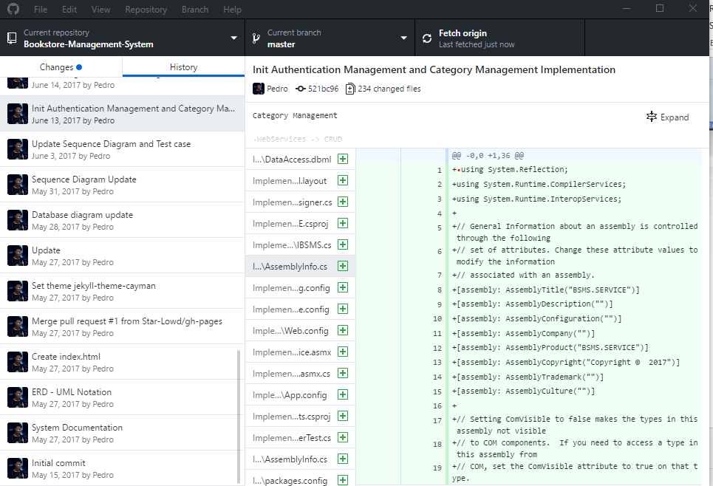


Version Control

Slide 12
Meeting Schedule
Subject | Capstone Project | Date | Every Saturday
Facilitator | Fpt University | Time | 10:30
Location | Fpt University campus high tech park, Hoa Lac | Scribe | Joshua David Kanda
Attendees | Supervisor
 | Olasehinde Ezekiel Olaoluwa
 | Shunom Peter Bala
 | Joshua David Kanda
Absentee | Olalekan Savage

Slide 13
Risk Management
NO | Risk Description | Probability | Effect | Strategy
People Risk
1 | Misunderstanding between team member can occur | High | Intermediate | Fix misunderstanding between team member to make the project flow continue
2 | Team member have different schedule | Low | Basic | Get all team members schedule and find suitable time to assign task
3 | Team members cannot meet task deadline | High | Advance | Push deadline forward and make plan that allow team member to work overtime inorder to finish before the next deadline

Slide 14

Coding Convention
Coding convention in our web application will strictly follows the camel case throughout, from the web services to the backend to the unit testing will strictly follow this rule.

Slide 15



Tools And Techniques

Slide 16
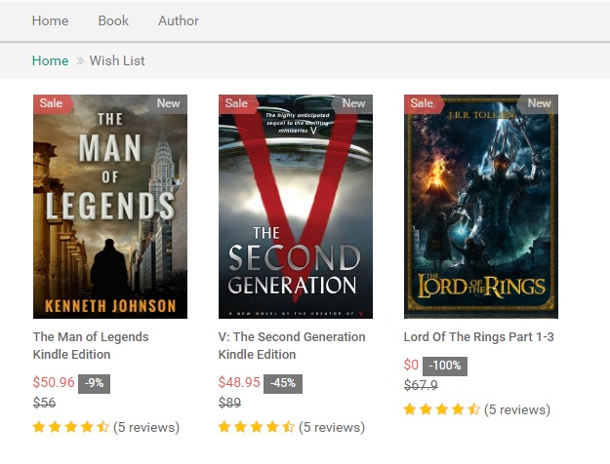
Requirement
Wishlist Management
Add Book to Wish list
Remove Book from Wish list

Slide 17

Requirement
Author Management
Add Author
Update Author
Delete Author
View Author Detail
Find Books By Author

Slide 18
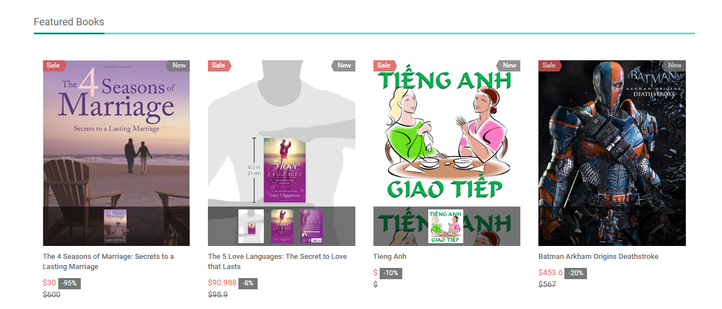
Requirement
Book Management
Add Book
Update Book
Delete Book
View Book Details
View Book Author
Like Book
Unlike Book
Rating

Slide 19
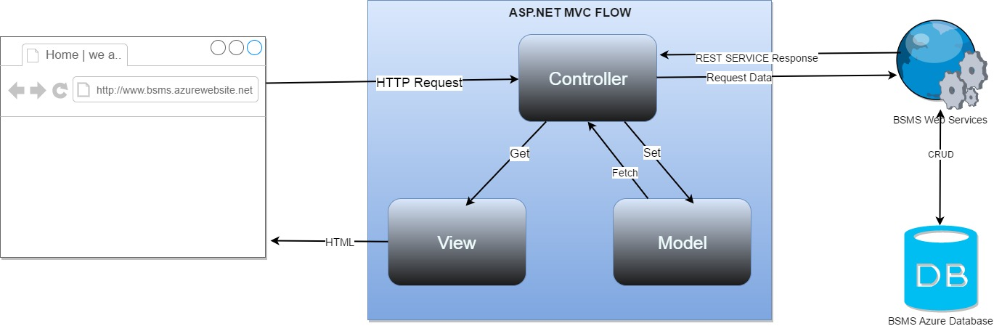
Design And Implementation
Design And Implementation

Slide 20
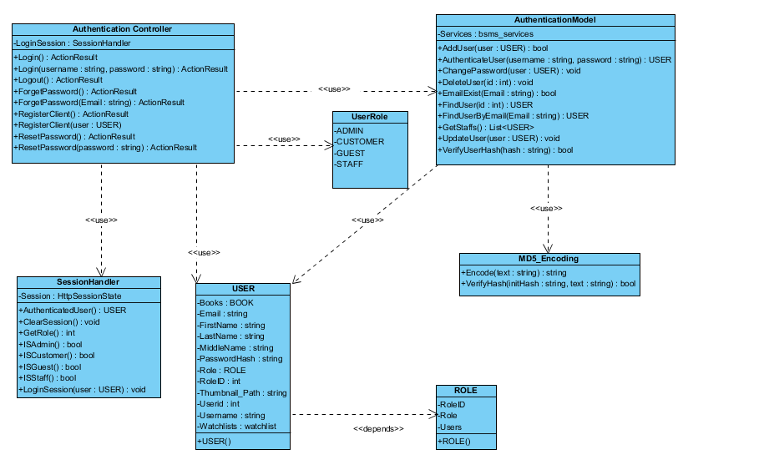
Design And Implementation
Class Diagram Sample

Slide 21
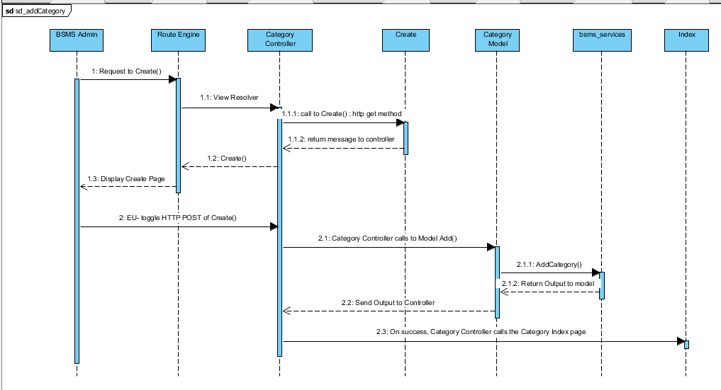
Design and Implementation
Sequence Diagram Sample

Slide 22
Test

Slide 23
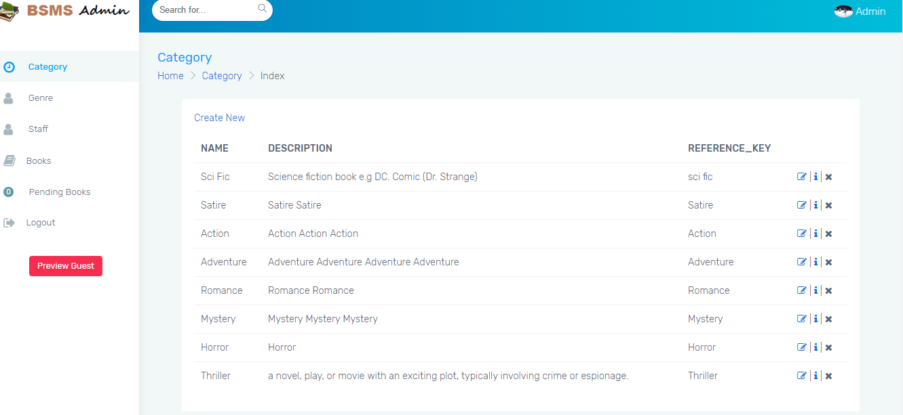
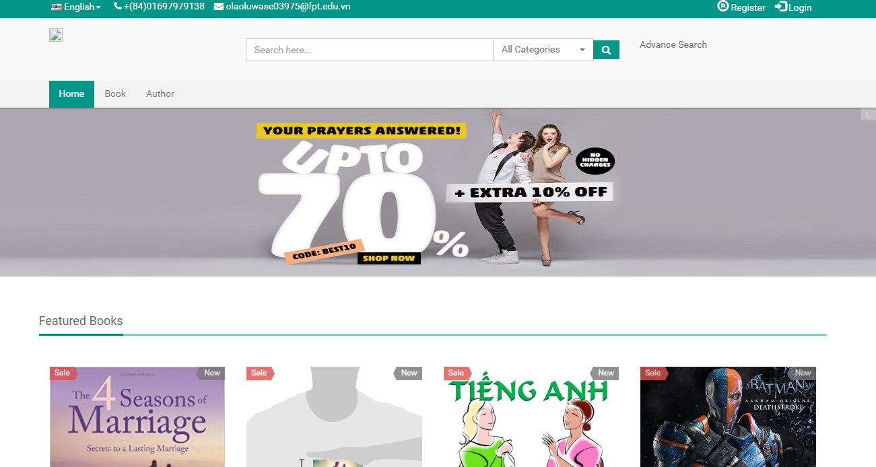
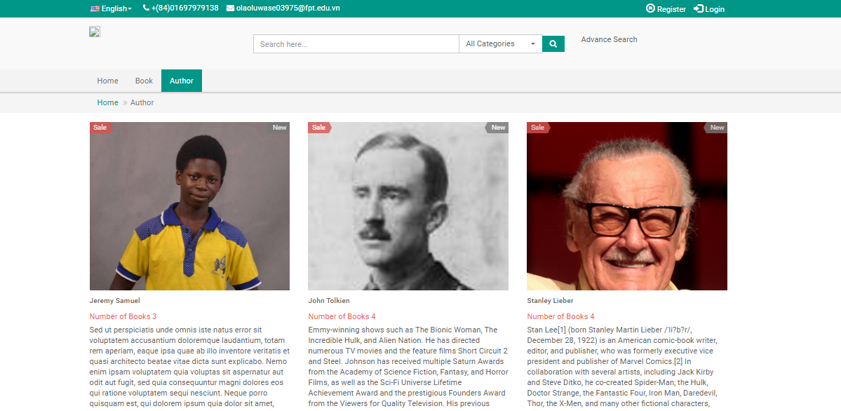
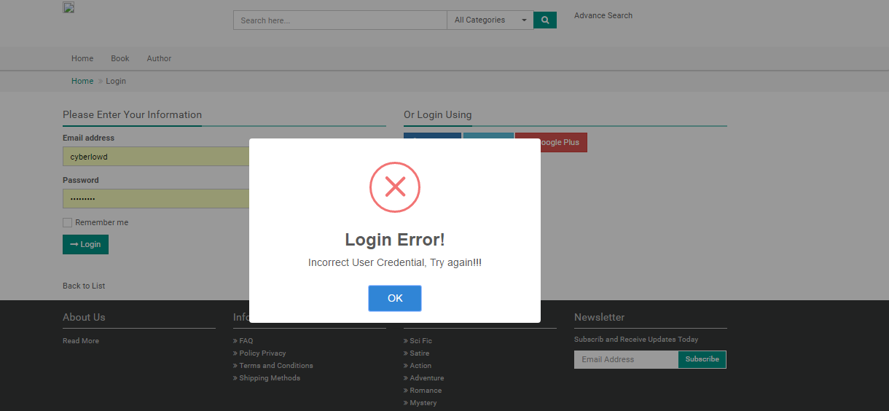
Demo

